Slide 1
HMP for IoT – The path to powerful ultra-efficient nodes
Mike Eftimakis
IoT Product Manager
Linley IoT Conference
July 2017

Slide 2
Agenda
What is HMP?
HMP for IoT
System design considerations

Slide 3
What is HMP?

Slide 4


What is HMP?
CPU
GPU
ISP
Video
Interconnect
Display
Audio
DSP
DDR
MCU
A heterogeneous system
using different compute elements
A heterogeneous subsystem
using different processors cores
Notes:
Heterogeneous system is a generic word and means different things when used in different contexts.
We use heterogeneous compute to refer a complex system that combines several different compute elements like CPU, GPU, DSP, Image processor, video processor and a display processor.
We also use the word heterogeneous compute to refer to the combination of different processors – for example ARM’s big.LITTLE technology is an example of heterogeneous compute.
In this talk, we are focusing on the heterogeneous compute using combinations of ARM’s Cortex processors.

Slide 5
Why heterogeneous computing?
Increase
system
performance
Increase
system
efficiency
Reduce
system
cost
“Right-sized processing”
Notes:
Increase system performance
Reduce system power consumption
Increase overall system efficiency
Maximize software reuse
Reduce system cost

Slide 6


Heterogeneous multicore processors
Multicore
Homogeneous
Heterogeneous
Performance asymmetry
Functional asymmetry
Same ISA
Different microarchitecture
Same view of memory
OS/Software symmetry
Different ISA
Different microarchitecture
Different view of memory
OS/Software asymmetry
Same ISA
Same microarchitecture
Same view of memory
Cortex-A + Cortex-M systems
Interconnect
Interconnect
Interconnect
Notes:
People have been doing this for years (decades) – mobile → AP + modem

Slide 7

Architectural differences between Cortex families
Cortex-A
Cortex-R
Cortex-M
Higher performance
Lower power, smaller area
Operating System
Rich OS/ RTOS
RTOS only
Instruction set
32/64b ARM and Thumb ISA
32b ARM and Thumb ISA
32b Thumb ISA
Interrupts
SW managed interrupts
Deterministic SW managed
HW managed interrupt
Bus interface
AMBA AXI
AMBA AXI
AMBA AHB/AXI
Ideal for user interface and media processing
Ideal for always-on processing
Notes:
Many will know difference… but for those who don’t this lists just some of the differences
At a simple level A = higher perf, M = lower power/area and R is in the middle
But there are other feature differences which define each profile
Now some of these are blurring
The cores do overlap in PPA
And features which were previously exclusively in one profile are now starting to appear outside this – so RichOS in Cortex-R
But some things we won’t be doing
-eg ASIL D Cortex-A
-eg adding an MMU to Cortex-M
From a markets point of view you can make some generalisations – A-profile in servers, r-profile in beaking systems, m-profile in microcontrollers
But this picture is also more complicated <click>

Slide 8
HMP for IoT

Slide 9



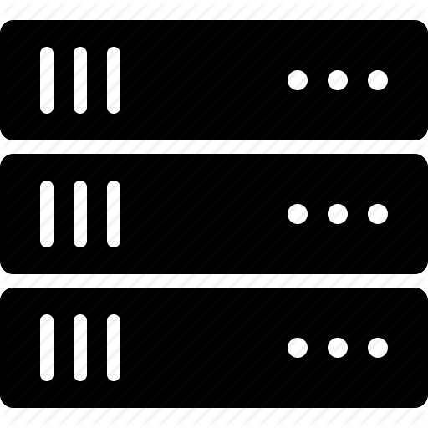




Focus on IoT Nodes and Gateways
IoT Nodes
Applications
Management
Sensor
Gateway
Base Station
Server
Actuator
Local
Global
Small data
Big data

Slide 10
Characteristics of IoT devices
Power constrained
  Battery operation
  Long usage life
Increasing performance
  More sensors
  Machine learning
  Complex control
Security
Low cost
Always ready
  Most of the time scanning
Side applications
  Voice control
  Smart sensing
Security
Low cost

Slide 11
Why HMP for IoT?
Need to process locally
  Low power
  High efficiency
  But low-cost
Other reasons
  Reuse SW ecosystem
  Rich UI
  Real-time control
  Context awareness
Cortex-A
Cortex-M

Slide 12


IoT systems have diverse workloads
Energy
Interactive mode
Search
Messages
Audio / Video
Calling
Ambient mode
Sensing
Notifications
Time / date
Calendar
Sleep mode
Time
Energy
Exception handling
Face recognition
Video streaming
Regular sampling
Check environment
Wait for trigger
RF scanning
Time
Notes:
Different requirements – real time vs high performance, general data processing, multimedia

Slide 13
HMP system example
18x
60x
More
performance
Less
power
Notes:
Cortex-A35
Runs Android OS
Performance optimized @1.9 GHz
Quad core cluster with1MB L2 cache
Cortex-M7
Low power, high performance, always-on sensor hub
Full config including caches, FPU
Clock frequency 200 MHz

Slide 14
System design considerations

Slide 15
System design considerations
Memory map fusion – partitioning
Security
Power optimization
Inter-processor communication
Software
Debug
Generic HMP compute subsystem using Cortex processors
Cortex-A
subsystem
Cortex-M
subsystem
AHB interconnect
Shared L2
Local memory
Interconnect
DMC
AHB interconnect
DDR
Sensor
Timer
SRAM

Slide 16
Memory map fusion – subsystem partitioning
Different memory maps
  Cortex-A – 48bit address space
  Cortex-M – 32bit
SMMU to virtualize Cortex-M address space
  Run-time configuration
  Memory mapped dynamically
  Independent application space
Peripherals
  Private – Local
  or shared with access controlled by SMMU
Cortex-A
CPU cluster
Cortex-M
subsystem
AXI /AHB interconnect
SMMU
Local memory and peripherals
AXI interconnect
DMC
AHB interconnect
DDR
Sensor
Timer
SRAM

Slide 17

Security
Cortex-M and Cortex-A can both support TrustZone
Virtualizing the Cortex-M address space with SMMU
  Each subsystem address space is independent
  Isolation from other Cortex-M systems through the SMMU
  Cortex-A system can control access and sharing
Secure enclave
  Accelerates crypto functions
  Hides keys from the rest of the system
  Form the root of Trust
  Handles life cycle state control and debug access control
Non-trusted
(normal)
Trusted
(secure)
Trusted software
Trusted hardware
Crypto
Secure system
Secure
storage
TRNG

Slide 18
Power optimization
Multiple power domains
  Reduce leakage current when not in use
Multiple system power state
  Include hibernation when system is idle for a long time
Built-in hardware based power control
  Dynamic power control with reduced SW overhead
Dynamic hierarchical clock gating

Slide 19
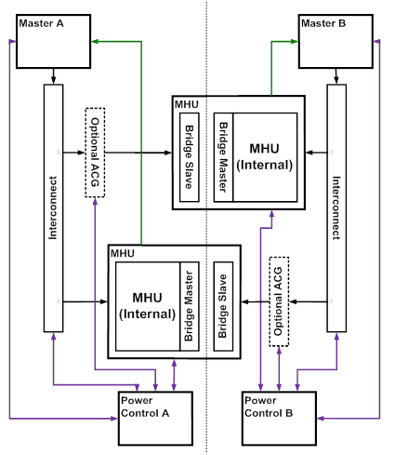
Inter-processor communication
Messaging
  Register based interrupt
  Shared memory for large messages
  Registers for small messages
Requirements
  Split power domain
  Clock crossing
  Receiver power down state

Slide 20
Example software concept
Cloud Services
Cortex-A Software Components
Cortex-M Software
Components
Cloud client
Linux Applications
Cortex-M Application
Cloud client
Provisioning
TEE
Linux
Secure
Data
RTOS
Secure services
U-Boot
Secure processes
Secure processes
System Platform . .
Security Enclave
SMMU
MHU
Secure/Non-Secure Peripherals

Slide 21
Example Software Concept 2
Cloud Services
Cortex-A Software
Cortex-M
Software
Cortex-M
Software
Cloud client
Linux Applications
Cortex-M Application
Cortex-M Application
RTOS
RTOS
Linux
Memory compartments
configured by the pico-visor
Secure processes
Secure processes
Secure
Services
Pico-visor
Secure processes
System Platform . .
Security Enclave
SMMU
MHU
Secure/Non-Secure Peripherals

Slide 22
Debug
Merged debug access solution
  Single Debug Access Port
  Access to each processor subsystem can be independently controlled
Cross triggering and shared timestamp between all systems
Support for certificate authentication
  Multiple CoreSight Authentication “zones”
Configurable trace support

Slide 23


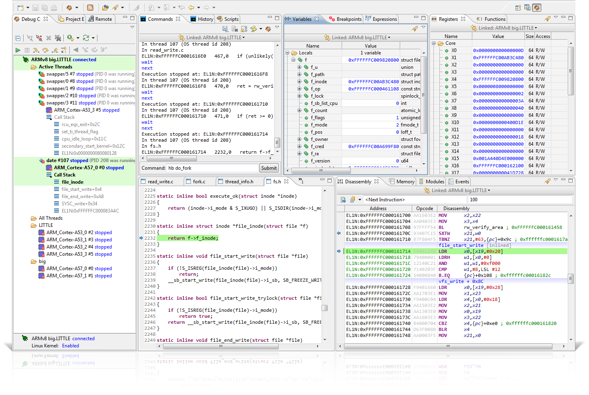
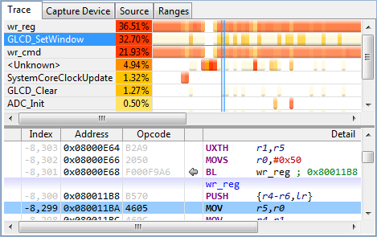
DS-MDK for Cortex-A/Cortex-M hybrid devices
Debug
Debug Linux/RTOS apps from a single tool
OS awareness
Analyze
Optimize

Slide 24
Conclusion
HMP is needed to enable more powerful IoT systems
Tools are available to start building HMP systems now
Talk to us about HMP

